Slide 1


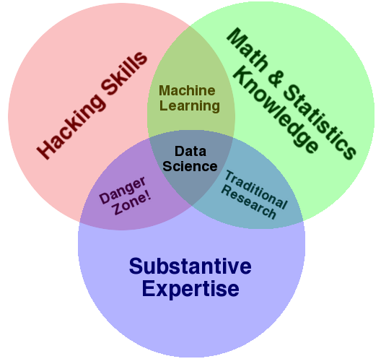
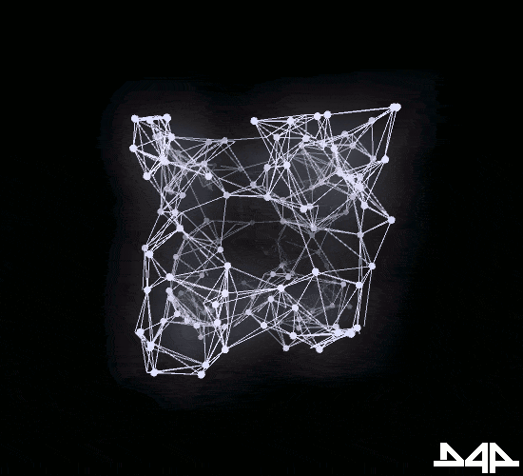
NEURAL IMAGE CAPTIONING
BY
ANKIT NITESH(1606645)
KUMAR AMBUJ(1606719)
MANISH KUMAR(1606723)
Deep Learning & AI

Slide 2
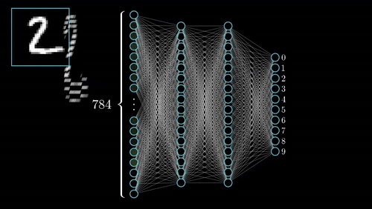


Slide 3
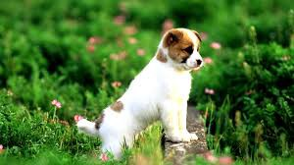
What do you see in the below picture?
Well some of you might say
“A white dog in a grassy area”, some may say
“White dog with brown spots” and yet some others might say “A dog on grass and some pink flowers”.

Slide 4

• Definitely all of these captions are relevant for this image and
there may be some others also. But the point I want to make is;
it’s so easy for us, as human beings, to just have a glance at a
picture and describe it in an appropriate language. Even a 5 year
old could do this with utmost ease.
But, can you write a computer program that takes an image as input
and produces a relevant caption as output?

Slide 5
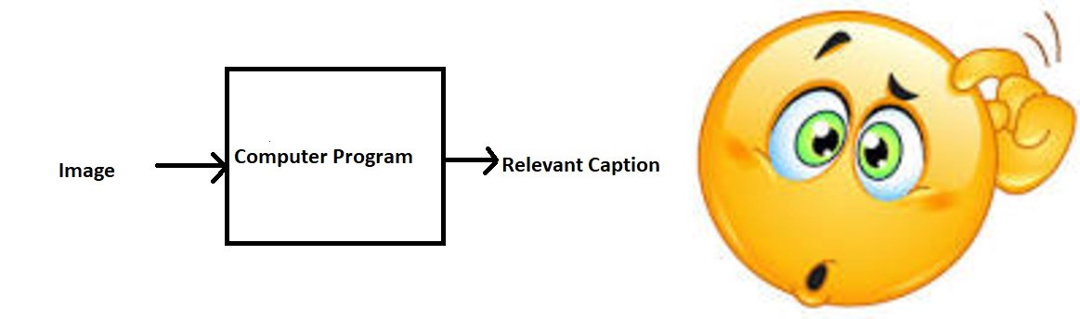
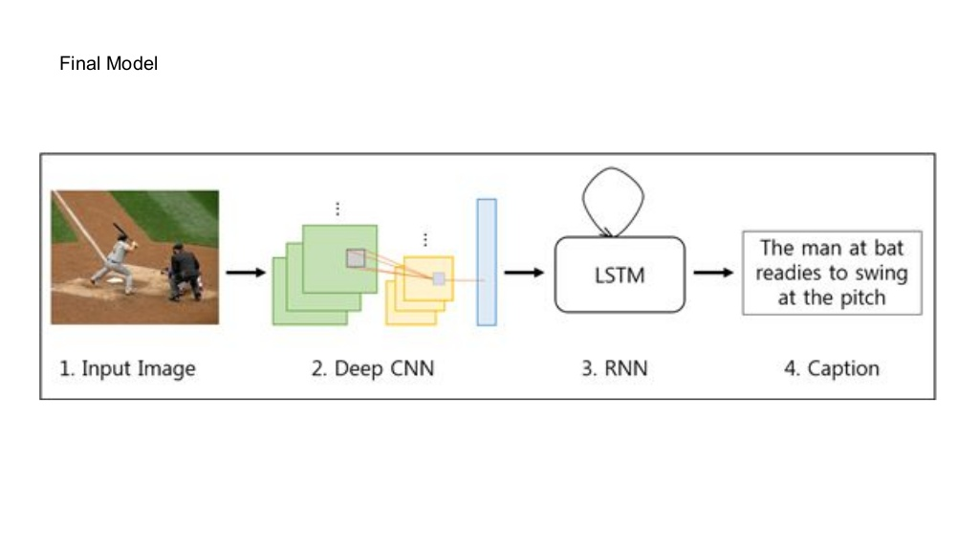

Slide 6
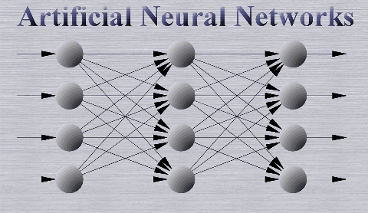



Slide 7

Motivation
Aid to the blind— We can create a product for the blind which will guide them travelling on the roads without the support of anyone else. We can do this by first converting the scene into text and then the text to voice. Both are now famous applications of Deep Learning.
Self driving cars— Automatic driving is one of the biggest challenges and if we can properly caption the scene around the car, it can give a boost to the self driving system.

Slide 8
Automatic Captioning can help, make Google Image Search as good as Google Search, as then every image could be first converted into a caption and then search can be performed based on the caption.
CCTV cameras (Closed-circuit television cameras) are everywhere today, but along with viewing the world, if we can also generate relevant captions, then we can raise alarms as soon as there is some malicious activity going on somewhere. This could probably help reduce some crime and/or accidents

Slide 9

Our Target
Automatically generate a sentence for an Image in a real time environment.
Capture semantic information of images and express in natural language.
To learn the concepts of CNN and LSTM model and build a working model by using neural network.

Slide 10
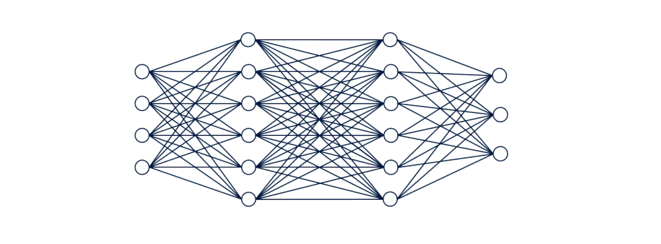
Working of the Model
Following are the steps to be followed to achieve the objective of the project during the project development:-
Data collection
Understanding the data
Data Cleaning
Loading the training set
Data Preprocessing(Images)
Data Preprocessing(Captions)
Data Preparation using Generator Function
Word Embedding
Model Architecture
Caption Generator

Slide 11

1. Data Collection:
A data set is a collection of related, discrete items of related data that may be accessed individually or in combination.
Data sets can also consist of a collection of documents or files.
Used the Flickr 8k dataset. This dataset contains 8000 images each with 5 captions.
These images are bifurcated as follows:
Training Set — 6000 images
Dev Set — 1000 images
Test Set — 1000 images

Slide 12

2. Understanding the data
Understand the attributes of the data.
Summarize the data by identifying key characteristics, such as data volume and total number of variables in the data.
Understand the problems with the data, such as missing values, inaccuracies, and outliers.
Visualize the data to validate the key characteristics of the data or unearth problems with the summary statistics.

Slide 13
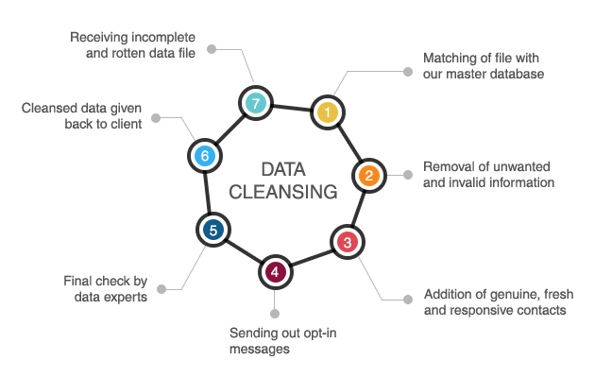
3. Data Cleaning
Data Cleaning means the process of identifying the incorrect, incomplete, inaccurate, irrelevant or missing part of the data and then modifying, replacing or deleting them according to the necessity.
Data cleaning may be performed interactively with data wrangling tools, or as batch processing through scripting.
Data cleaning is not simply about erasing information to make space for new data, but rather finding a way to maximize a data set’s accuracy without necessarily deleting information.

Slide 14
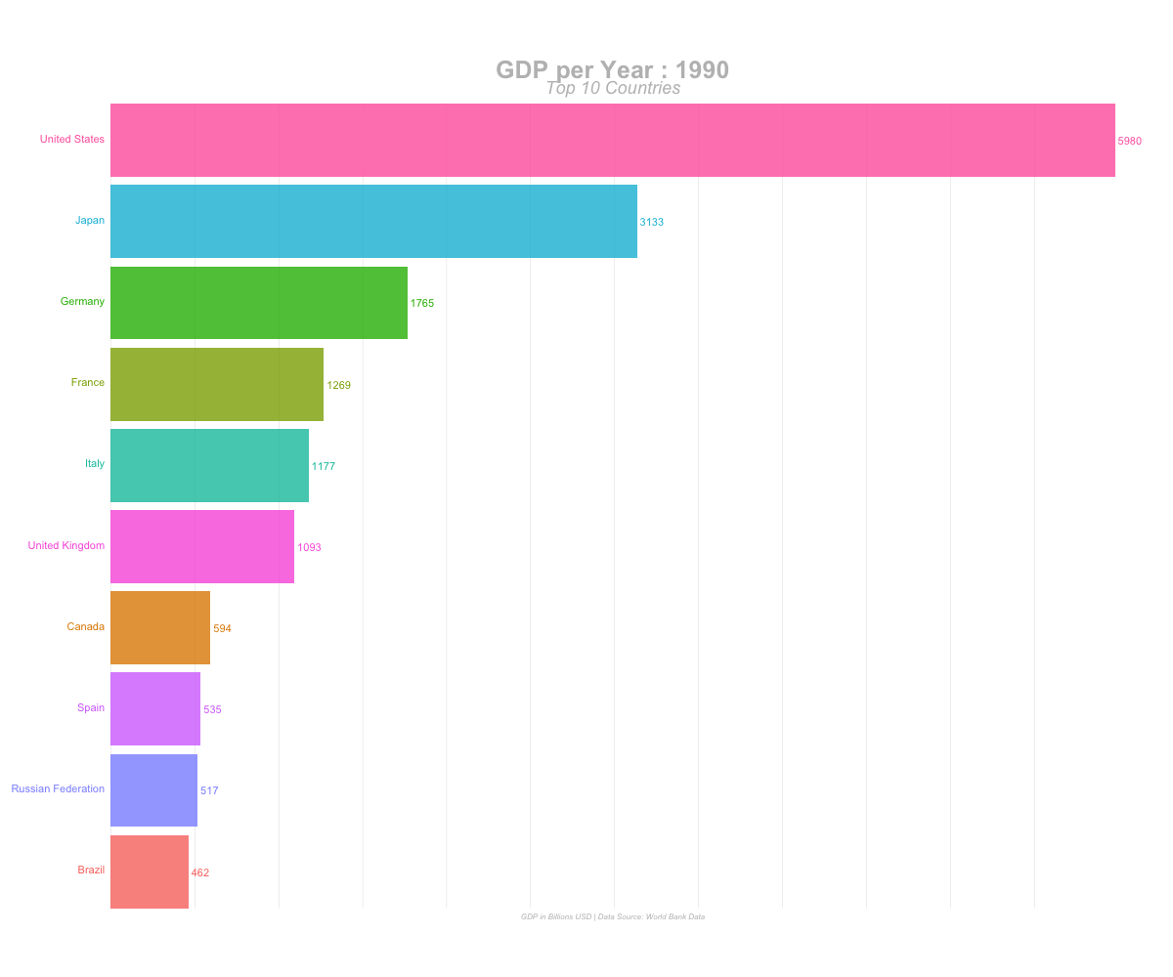

4. Loading the training set
The training set is the material through which the computer learns how to process information.
The training data is an initial set of data used to help a program understand how to apply technologies like neural networks to learn and produce sophisticated results.
Because the machine learning program is so complex and so sophisticated, Convolutional Neural Networks uses iterative training on each of those images to eventually be able to recognize features, shapes and even subjects such as people or animals.

Slide 15
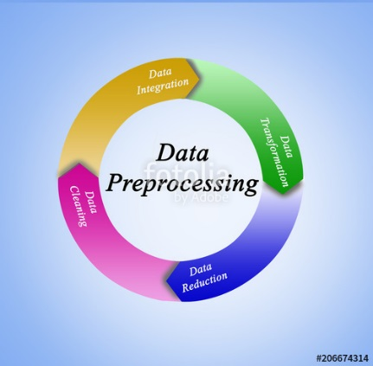
5. Data Preprocessing – Images
An image is nothing more than a two-dimensional array of numbers(or pixels) ranging between 0 and 255. It is defined by the mathematical function f(x,y) where x and y are the two co-ordinates horizontally and vertically.
Preprocessing is common name for operations with images at the lowest level of abstraction –- both input and output are intensity images.
We need to convert every image into a fixed sized vector which can then be fed as input to the neural network.
The aim is improvement of the image data that suppresses unwanted distortions or enhances some image features important for further processing.

Slide 16
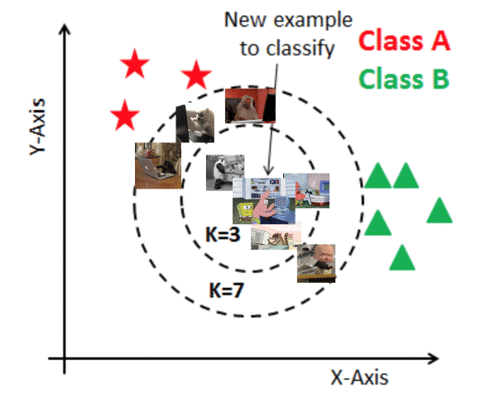
6. Data Preprocessing - Captions
Captions are something that we want to predict. So during the training period, captions will be the target variables (Y) that the model is learning to predict.
But the prediction of the entire caption, given the image does not happen at once.It will predict the caption word by word. Thus, we need to encode each word into a fixed sized vector.

Slide 17
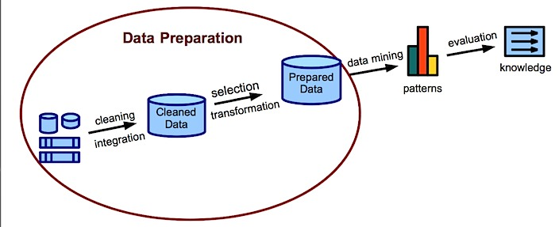
7. Data Preparation using Generator Function
A generator function is defined like a normal function, but whenever it needs to generate a value, it does so with the yield keyword rather than return. If the body of a def contains yield, the function automatically becomes a generator function.”
Generator are functions that yield result, suspend the operation and then resume the operation.
Generators produce values one-at-a-time as opposed to giving them all at once.

Slide 18
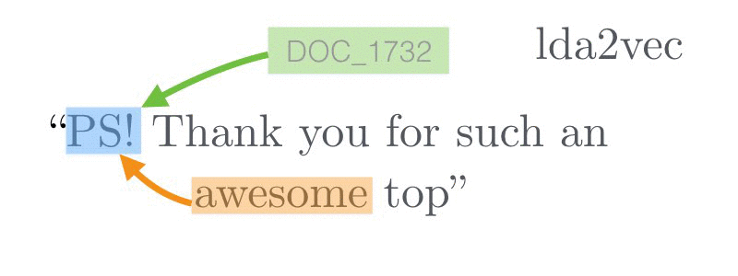
8. Word Embeddings
A word embedding is a learned representation for text where words that have the same meaning have a similar representation.
It is this approach to representing words and documents that may be considered one of the key breakthroughs of deep learning on challenging natural language processing problems
Each word is represented by a real-valued vector, often tens or hundreds of dimensions.

Slide 19
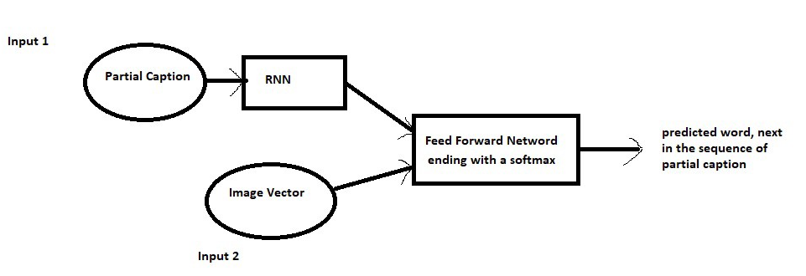
9. Model Architecture
An architectural model is a type of scale model – a physical representation of a structure – built to study aspects of an architectural design or to communicate design ideas.

Slide 20
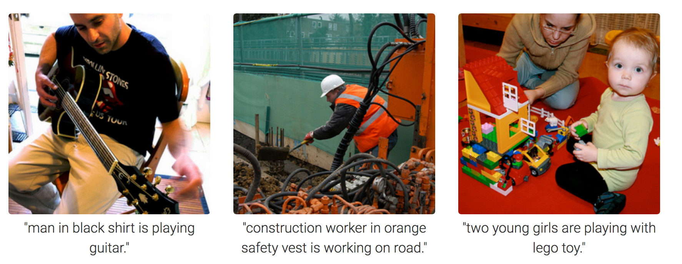
10. Caption Generator
Image caption generator is a task that involves computer vision and natural language processing concepts to recognize the context of an image and describe them in a natural language like English.
In the final step-testing of model is done by passing new images that is captions are generated for new test images.
Captions are generated iteratively, one word at a time.

Slide 21
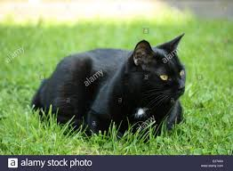
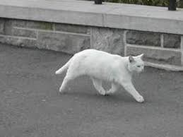
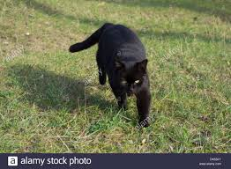
Caption -> The black cat sat on grass
Caption -> The white cat is walking on road
Caption -> The black cat is walking on grass

Slide 22

Deep Learning & AI

